Slide 1
SYLLOGISM

Slide 2
Syllogism is an important section on logical reasoning and hence its comprehension needs more than normal attention. It is a very interesting topic where the logical thinking and the decision making skills are highly tested.
The term syllogism means inference or conclusion drawn from the statements. The question of syllogism can be solved with the help of Venn diagrams.
In syllogism, a statement of certain relation between two or more terms is analogous to a sentence is grammar.
The proposition consists of three parts, namely subject, predicate and copula.
Subject: The subject is about which something is said.
Predicate: The predicate is the part of the proposition denoting which is affirmed or denied about the subject.
Copula: The copula is that part of the proposition which denotes the relation between the subject and the predicate.

Slide 3
Example:
Consider the proposition ‘Man is intelligent’.
Here the information is given about the man.
So ‘Man’ is the subject.
‘Intelligent’ is the quality affirmed for this subject. So it is the predicate.
‘Is’ denotes the relation between the subject and the predicate. So, it is the copula.
Structure of the Question
Syllogism questions always starts with the directions to answer.
In each question we could find two segments i.e., statements and conclusions.
Always consider the information provided in the statements is true.
Check whether the conclusions follow the statements and answer as per the direction.

Slide 4
Reap to Remember
Four possible forms of statements or conclusions:
1. All A is B.
2. Some A is B.
3. Some A are not B.
4. No A is B.
Applying the Venn diagram method will be very easy to solve any question. Go through the following basic representations of the statements.

Slide 5
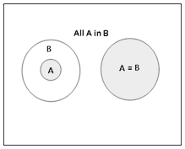
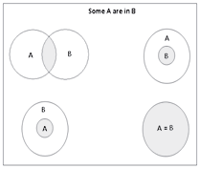
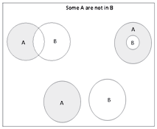
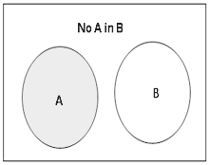
Possible Diagrams:

Slide 6
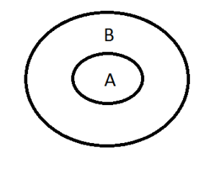
CONCEPT 1 – All A is B
The Diagram is,
The Possible conclusions are,
All A is B.
Some A is B.
Some B is A.

Slide 7
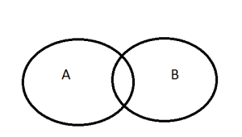
CONCEPT 2 - Some A is B.
The Diagram for Some A is B is
The possible conclusions are,
1) Some A is B
2) Some B is A

Slide 8
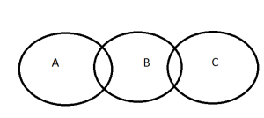
CONCEPT 3 – Some A is B and Some B is C
The Diagram is,
Now the Possible Conclusions are,
Between A and B Between B and C
Some A is B Some B is C
Some B is A Some C is B
There is no DIRECT CONNECTION between A and C. So it is not possible to derive any conclusion between A and C.

Slide 9
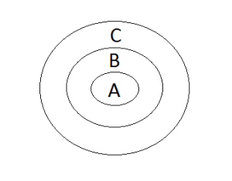
CONCEPT 4 – All A is B and All B is C
The Conclusions are,
Between A and B Between B and C Between A and C
All A is B. All B is C. All A is C.
Some A is B. Some B is C. Some A is C.
Some B is A. Some C is B. Some C is A.

Slide 10
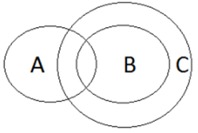
Concept 5 – Some A is B, All B is C.
The possible conclusions are,
Between A and B Between B and C Between A and C
Some A is B All B is C Some A is C
Some B is A Some B is C Some C is A
Some C is B

Slide 11
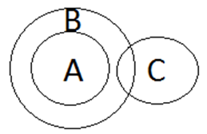
Concept 6 – All A is B and Some B is C
The possible conclusions are,
Between A and B Between B and C
All A is B Some B is C
Some A is B Some C is B
Some B is A
There is no DIRECT CONNECTION between A and C. So, it is not possible to derive any conclusion between A and C.

Slide 12
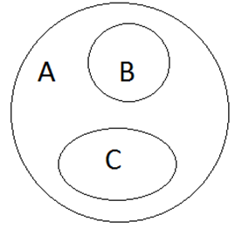
Concept 7 – All B is A and All C is A
The Possible Conclusions are,
Between A and B Between A and C
All B is A All C is A
Some B is A Some C is A
Some A is B Some A is C
There is no DIRECT CONNECTION between B and C. So it is not possible to derive any conclusion between B and C.

Slide 13
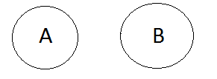
Concept 8 – No A is B
The Possible Conclusions are,
No A is B
No B is A
Some A is not B
Some B is not A

Slide 14
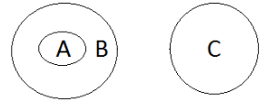
Concept 9 – All A is B and No B is C
The Possible Conclusions are,
Between A and B Between B and C Between A and C
All A is B No B is C No A is C
Some A is B No C is B Some A is Not C
Some B is A Some B is not C
Some C is not B

Slide 15
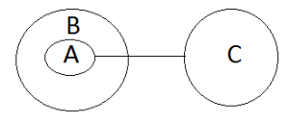
Concept 10 – All A is B and No A is C
The Possible Conclusions are,
Between A and B Between A and C Between B and C
All A is B No A is C Some B is not C
Some A is B No C is A
Some B is A Some A is not C
Some C is not A

Slide 16
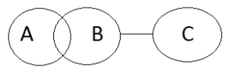
Concept 11 – Some A is B; No B is C
The Possible Conclusions are,
Between A and B Between B and C Between A and C
Some A is B No B is C Some A is not C
Some B is A No C is B
Some B is not C
Some C is not B

Slide 17
Concept 11 – Some A is B; No B is C
The Possible Conclusions are,
Between A and B Between B and C Between A and C
Some A is B No B is C Some A is not C
Some B is A No C is B
Some B is not C
Some C is not B

Slide 18
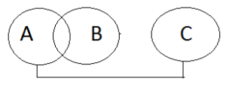
Concept 12 – Some A is B; No A is C
The Possible Conclusions are,
Between A and B Between A and C Between B and C
Some A is B No A is C Some B is not C
Some B is A No C is A
Some A is not C
Some C is not A

Slide 19
Statements: Some bats are balls.
No ball is a wicket.
Conclusions: I. Some wickets are not bat.
II. All wickets being bat is a possibility.
Conclusion I follows
Conclusion II follows
Either conclusion I or conclusion II follows
Neither conclusion I or conclusion II follows
Both conclusion I and conclusion II follow
Statements: All tables are chairs.
No chair is a couch.
Conclusions: I. At least some couches are chairs.
II. No table is a couch.
Conclusion I follows
Conclusion II follows
Either conclusion I or conclusion II follows
Neither conclusion I or conclusion II follows
Both conclusion I and conclusion II follow

Slide 20
Statement: No tea is coffee.
No milk is tea.
Conclusions: I. No coffee is milk.
II. All milk are coffee.
Conclusion I follows
Conclusion II follows
Either conclusion I or conclusion II follows
Neither conclusion I or conclusion II follows
Both conclusion I and conclusion II follow
Statements: Some boys are girls.
Some girls are women.
All women are men.
Conclusions: I. Some men are girls.
II. All boys being men is a possibility.
Neither I nor II follows
Only I follows
Either I or II follows
Both I and II follow
Only II follows

Slide 21
Statements: All lions are tigers.
No tiger is dog.
All dogs are cats.
Conclusions: I. All lions are cats.
II. Some cats are tigers.
Neither I nor II follows
Only I follows
Either I or II follows
Both I and II follow
Only II follows
Statements: No red is a black.
All blacks are greens.
All greens are yellows.
Conclusions: I. All blacks are yellows.
II. At least some yellows are greens.
A. Neither I nor II follows B. Only I follows
C. Either I or II follows D. Both I and II follow
E. Only II follows

Slide 22
Statements: Some caps are hats.
Some hats are shirts.
Many shirts are ties.
Conclusions: I. Some caps are ties.
II. Not a single cap is tie.
A. If only conclusion I follow B. If only conclusion II follow
C. If neither conclusion I nor conclusion II follows
D. If both the conclusions follow
E. If either conclusion I or conclusion II follows.
Statements: All floors are buildings.
All doors are buildings.
Some buildings are not houses.
Conclusions: I. Some floors are not doors.
II. Some houses may not be buildings.
A. If only conclusion I follow B. If only conclusion II follow
C. If neither conclusion I nor conclusion II follows
D. If both the conclusions follow
E. If either conclusion I or conclusion II follows.

Slide 23
Statements: A few salesmen are girls.
All girls are saleswomen.
Some saleswomen are housewives.
Conclusions: I. A few saleswomen are salesmen.
II. Some housewives are girls.
A. If only conclusion I follow B. If only conclusion II follow
C. If neither conclusion I nor conclusion II follows
D. If both the conclusions follow
E. If either conclusion I or conclusion II follows.
Statements: A few Ostriches are Peacocks.
All Peacocks are Swans.
Some Swans are Ducks.
Conclusions: I. A few Swans are Ostriches.
II. Some Ducks are Peacocks.
A. If only conclusion I follow B. If only conclusion II follow
C. If neither conclusion I nor conclusion II follows
D. If both the conclusions follow
E. If either conclusion I or conclusion II follows

Slide 24
Statements:
Some cars are four-wheelers.
All cars are tricycles.
Conclusions:
A. No tricycles are four-wheelers
B. All four-wheelers are tricycles
C. Some tricycles are four-wheelers
D. None of the above

Slide 25
Statements: A few parrots are not pigeons.
All pigeons are white.
No white is green.
Conclusions: I. No green is a pigeon.
II. No parrot is green.
III. Some pigeons are not parrots.
A. Only C1 follows B. Either C1 or C2 follows
C. Only C2 and C3 follow D. All follow
E. None of these
Statement: Some hours are minutes.
All clocks are minutes.
No minute is second.
Conclusions: I. Some hours are clocks.
II. All seconds being clocks is a possibility.
III. No hour is a clocks.
A. Only C3 follows B. Either C1 or C3 follows C. Only C2 and C3 follow D. All follow
E. None of these

Slide 26
Statements: No coke is sprite.
No pepsi is coke.
Conclusions: I. No sprite is pepsi.
II. All pepsi are sprite.
Conclusion I follows
Conclusion II follows
Either conclusion I or conclusion II follows D
Neither conclusion I or conclusion II follows
Both conclusion I and conclusion II follow

Slide 27
Statements: A few wheels are warm.
Only wheels are wools.
Conclusions: I. Some wheels are wools.
II. All wools are warm.
A. If only conclusion I follows. B. If only conclusion II follows.
C. If both conclusion I and II follow. D. If neither conclusion I nor II follows.
E. Either conclusion I or II follows.
Statements: No newspaper is magazine.
Not a single magazine is book.
Every book is story.
Conclusions: I. Some stories which are books are newspapers as well.
II. No newspaper is a book.
III. Some stories are not magazines.
A. Only C3 follows B. Either C1 or C2 follows
C. Only C2 and C3 follow D. All follow
E. None of these.

Slide 28
Statements: Only fantastic are fans.
All fans are fabulous.
Conclusions: I. All fantastic are fabulous.
II. Some fabulous are fantastic.
A. If only conclusion I follows. B. If only conclusion II follows.
C. If both conclusion I and II follow. D. If neither conclusion I nor II follows.
E. Either conclusion I or II follows.
Statements: All toys are tasks.
No task is a tree.
Conclusions: I. No tree is a task.
II. A few tasks are toys.
A. If only conclusion I follows. B. If only conclusion II follows.
C. If both conclusion I and II follow. D. If neither conclusion I nor II follows.
E. Either conclusion I or II follows.

Slide 29
Statements: Only Rama is a clerk.
100% honest are clerks.
Conclusions: I. All honest are Rama.
II. All clerks being honest is a possibility.
A. Only conclusion II follows B. Either conclusion I or II follows
C. Only conclusion I follows D. Both conclusions I and II follow
E. Neither conclusion I nor II follows
Statements: A few figures are images.
0% snaps are images.
Conclusions: I. Some figures are not snaps.
II. All images being snaps is a possibility.
A. Only conclusion I follows B. Only conclusion II follows
C. Either conclusion I or II follows
D. Both conclusions I and II follow
E. Neither conclusion I nor II follows

Slide 30
Statements: Only a few teachers are doctors.
0% teachers are lawyers.
Conclusions: I. All lawyers are teachers.
II. Some doctors are not lawyers.
A. If only conclusion I follows B. If only conclusion II follows
C. If neither conclusion I nor II follows
D. If both conclusions I and II follow
E. if either conclusion I or II follows
Statements: All circles are squares.
Some squares are rectangles.
Conclusions: I. All rectangles being squares is a possibility.
II. All circles are rectangles.
A. Only conclusion I follows B. Only conclusion II follows
C. Both conclusions I and II follow
D. Neither conclusion I nor II follows
E. Either conclusion I or II follows

Slide 31
Directions for Q21 and Q22:
Each question has a set of four statements. Each statement has three segments. Choose the alternative where the third segment in the statement can be logically deduced using both the preceding two, but not just from one of them.

Slide 32
21.
A. No cowboys laugh. Some who laugh are sphinxes. Some sphinxes are not cowboys.
B. All ghosts are florescent. Some ghosts do not sing. Some singers are not florescent.
C. Cricketers indulge in swearing. Those who swear are hanged. Some who are hanged are not cricketers.
D. Some crazy people are pianists. All crazy people are whistlers. Some whistlers are pianists.
A and B
C only
A and D
D only
Ans: C

Slide 33
22.
A. Dinosaurs are prehistoric creatures. Water-buffaloes are not dinosaurs. Water-buffaloes are not prehistoric creatures.
B. All politicians are frank. No frank people are crocodiles. No crocodiles are politicians.
C. No diamond is quartz. No opal is quartz. Diamonds are opals.
D. All monkeys like bananas. Some GI Joes like bananas. Some GI Joes are monkeys.
C only
B only
A and D
B and C
Ans: B

Slide 34
